Slide 1
Mamba
Linear-Time Sequence Modeling with Selective State Spaces

Slide 2
Introduction
Structured state space sequence models (SSMs) promising class of architectures for sequence modeling
Combination of RNNs and CNNs
Computed very efficiently with linear or near-linear scaling in sequence length
Many SSMs successful in continuous signal data (audio and vision), but less effective at discrete and information-dense data (text)
Selective state space models achieve the modeling power of Transformers while scaling linearly in sequence length

Slide 3
Key limitation of prior models - ability to efficiently select data in an input-dependent manner
By parameterizing the SSM parameters based on the input, filter out irrelevant information and remember relevant information
Prior SSMs models must be time- and input-invariant in order to be computationally efficient, but with a hardware-aware algorithm that computes the model recurrently with a scan instead of convolution (3× faster on A100 GPUs)

Slide 4
The Need for Efficient Sequence Modeling
Traditional Transformer models face computational inefficiencies when handling long sequence data, necessitating the development of more efficient architectures like Mamba.
Mamba is a novel neural network architecture designed to efficiently handle long sequence data by utilizing selective state space models (SSMs) that scale linearly with sequence length.

Slide 5
Selection as a Means of Compression
The problem of sequence modeling is compressing context into a smaller state.
Autoregressive inference requires explicitly storing the entire context, which causes the slow linear-time inference and quadratic-time training of Transformers
Recurrent models are efficient because they have a finite state, implying constant-time inference and linear-time training.
Effective models are characterized by how well this state has compressed the context.
Efficient models are characterized by how well this state has compressed the content.

Slide 6
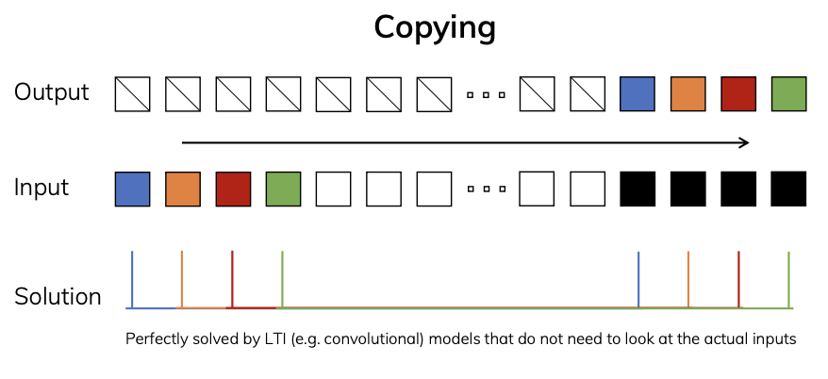
Synthetic Tasks
The standard version of the Copying task involves constant spacing between input and output elements and is easily solved by time-invariant models such as linear recurrences and global convolutions.

Slide 7
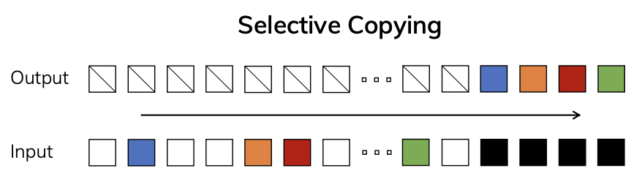
Synthetic Tasks
The Selective Copying task has random spacing in between inputs and requires time-varying models that can selectively remember or ignore inputs depending on their content.
Requires content-aware reasoning.

Slide 8
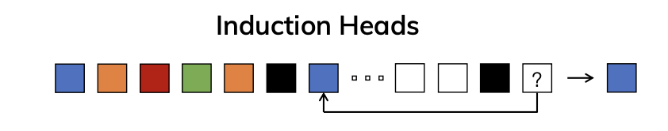
Synthetic Tasks
The Induction Heads task is an example of associative recall that requires retrieving an answer based on context, a key ability for LLMs.
Requires context-aware reasoning.

Slide 9
Simplified Architecture Design
H3 architecture is the basis for the most SSM architectures
Mamba combines the H3 block with the ubiquitous MLP block into single block, ie, stacked homogenously, inspired by the gated attention unit (GAU).
Compared to the H3 block, Mamba replaces the first multiplicative gate with an activation function.
Compared to the MLP block, Mamba adds an SSM to the main branch
The number of SSM parameters are much smaller in comparison
For 𝜎 we use the SiLU / Swish activation

Slide 10
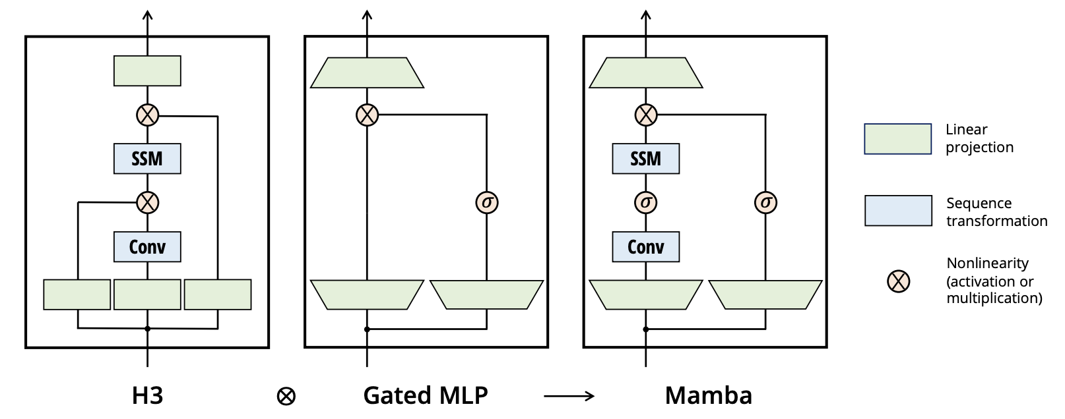

Slide 11
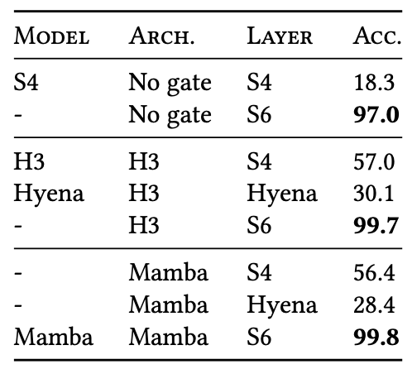
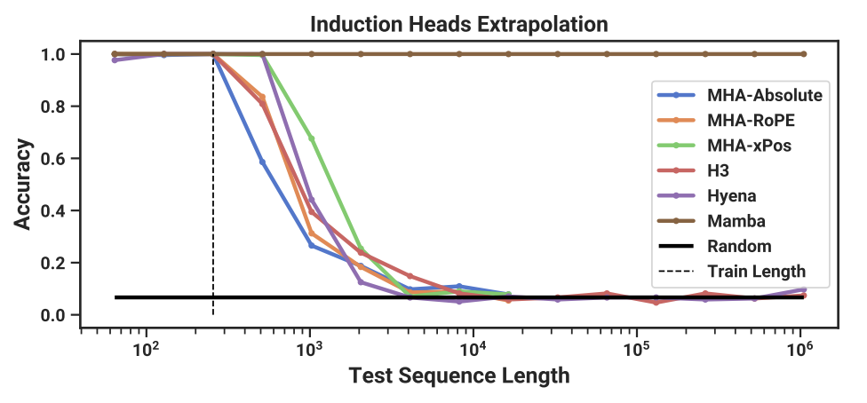
Empirical Evaluation - Synthetic Tasks
Mamba demonstrates the ability to solve important synthetic tasks such as selective copying and induction heads, extrapolating solutions indefinitely long (>1M tokens).

Slide 12
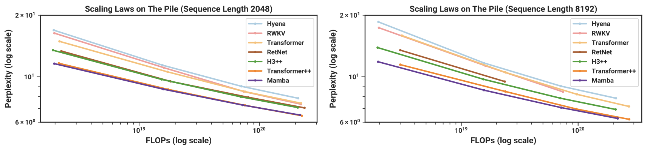
Empirical Evaluation - Language Modeling
Mamba achieves Transformer-quality performance in pretraining perplexity and downstream evaluations, with 5× generation throughput compared to Transformers of similar size.
Mamba scales better than all other models as the sequence length grows.

Slide 13
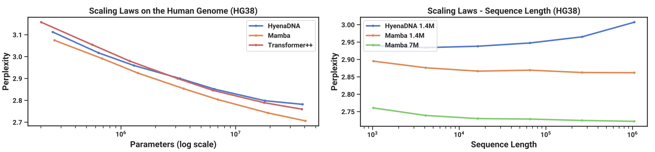
Empirical Evaluation - Audio and Genomics Modeling
Mamba outperforms prior models on modeling audio waveforms and DNA sequences, demonstrating improved performance with longer context up to million-length sequences.
Mamba facilitates better performance with increasing context length and model size

Slide 14
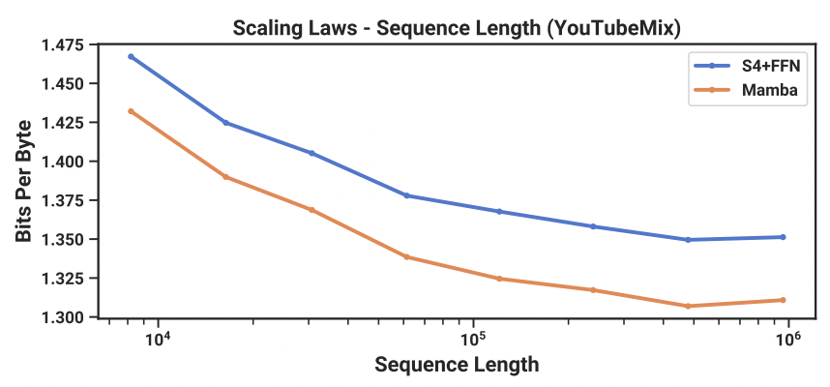

Slide 15
Computational Efficiency
Mamba's efficient scan is 40× faster than a standard implementation during training, and achieves 5× higher throughput than Transformers during inference, making it a practical and efficient choice for large-scale sequence modeling tasks.
The model's linear scaling in sequence length during training and its ability to handle long contexts effectively position it as a scalable solution for diverse applications.

Slide 16
Future Research
Open-Source Model Code: The authors have open-sourced the model code and pre-trained checkpoints to facilitate further research and application, empowering the broader research community to leverage and build upon the Mamba architecture.

Slide 17
Conclusion
Mamba perform context-dependent reasoning while scaling linearly in sequence length.
It matches or exceeds the performance of strong Transformer models.
Mamba is positioned as a general sequence model backbone with the potential to impact various domains, such as genomics, audio, and video.

